Slide 1

Time Series Analysis

Slide 2

Overview
What is Time Series?
Model: ARIMA
Model: SARIMA
Mathematical Example
What is Time Series Analysis?
Application
Components of Time Series
Advantages & Disadvantages
Goals of Time Series Analysis
Types of Models

Slide 3
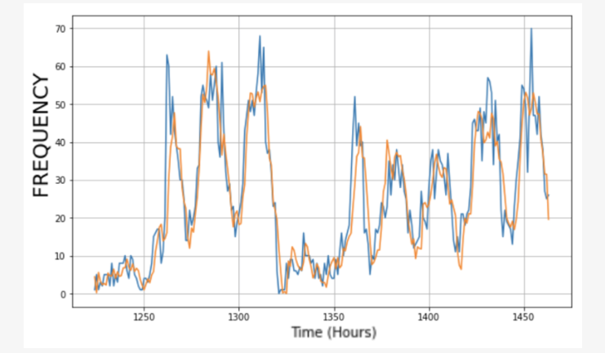
What is Time Series?
A time series is a sequence of data points collected or recorded at specific time intervals. Each data point is associated with a corresponding time stamp or period
Fig: Weather Forecasting Prediction

Slide 4
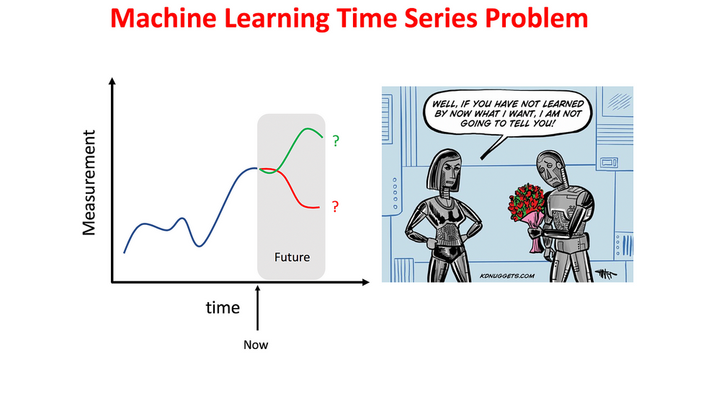
What is Time Series Analysis?
Time series analysis is a statistical and data analysis technique used to uncover patterns, trends, and insights within time series data. It involves applying various methods and models to extract meaningful information from temporal datasets
Fig: Representation of Time Series Analysis

Slide 5
Components of a Time Series
1
Trend
2
Seasonal
3
Cyclical
4
Irregular
Which is symbolized with
T
Which is symbolized with
S
Which is symbolized with
C
Which is symbolized with
I

Slide 6
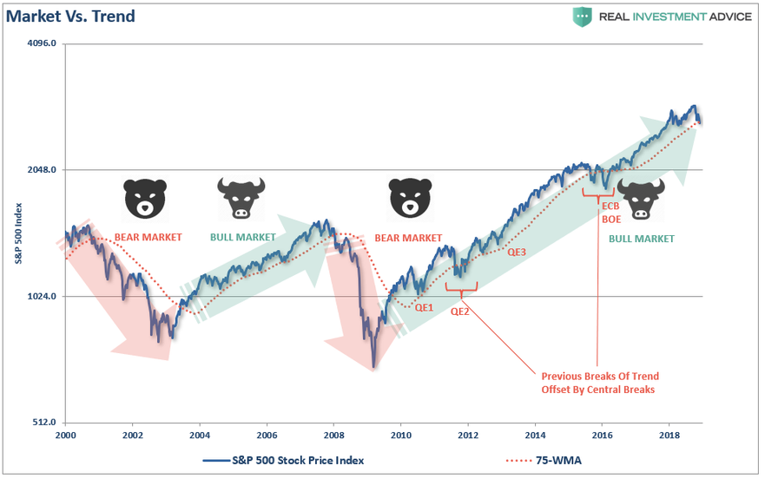
Trend (T)
The trend component represents the long-term direction in the data. It shows whether the values are generally increasing, decreasing, or remaining relatively stable over time
Example: In stock prices, a rising trend might indicate a bull market, while a declining trend could suggest a bear market
Fig: Stock Market Analysis

Slide 7
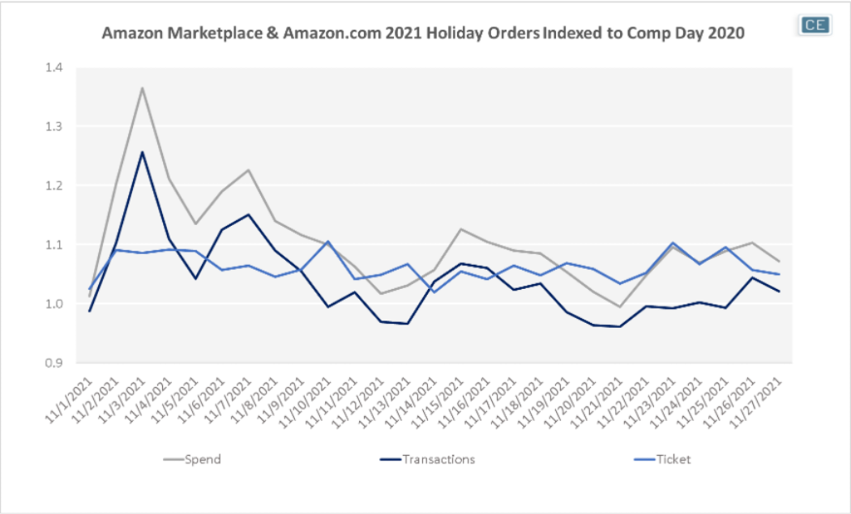
Seasonal (S)
Seasonality refers to repeating patterns or cycles in the data at fixed intervals. These intervals can be daily, weekly, monthly, or yearly, depending on the nature of the data
Example: Retail sales often exhibit seasonality, with higher sales during holiday seasons
Fig: Amazon Marketplace Analysis

Slide 8
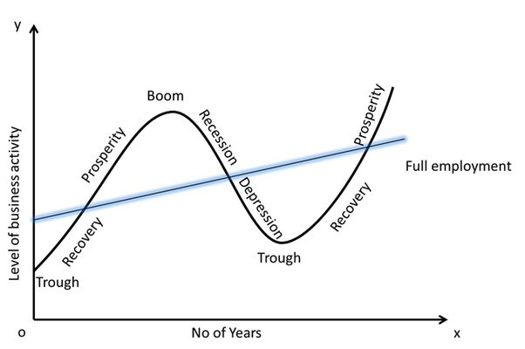
Cyclical(C)
Cyclic patterns are long-term undulating movements in the data that are not strictly fixed to a particular time frame, unlike seasonality. They typically have longer durations and do not repeat with the same regularity
Example: Economic cycles, like the boom and bust phases in business, may exhibit cyclic behavior
Fig: Boom & Bust Cycle Analysis

Slide 9
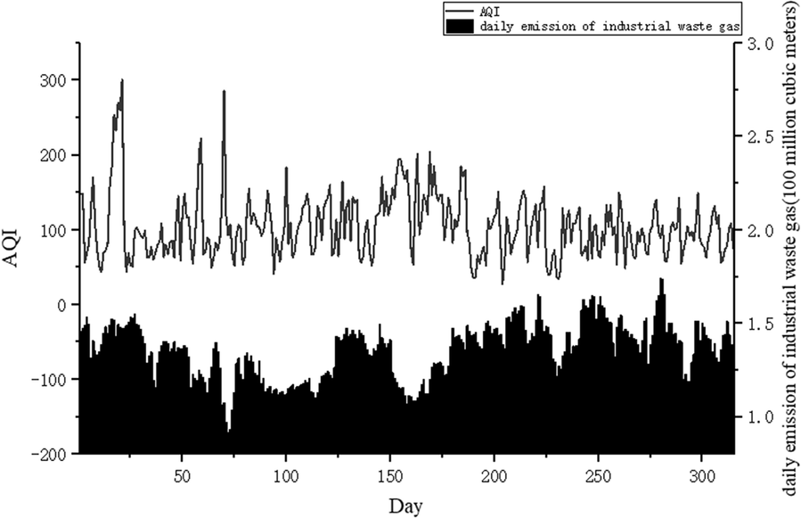
Irregular (I)
The Irregular or Noisy component represents random variations and unpredictable fluctuations in the data that cannot be attributed to trends or seasonality
Example: In weather data, daily temperature fluctuations due to various factors are considered noise
Fig: Air Quality Analysis

Slide 10

Goals of Time Series Analysis
Understanding
Prediction
Anomaly Detection
Data-Driven Decision-Making
Pattern Recognition
Model Development
Evaluation
Optimization
Adaptation
Hypothesis Testing

Slide 11
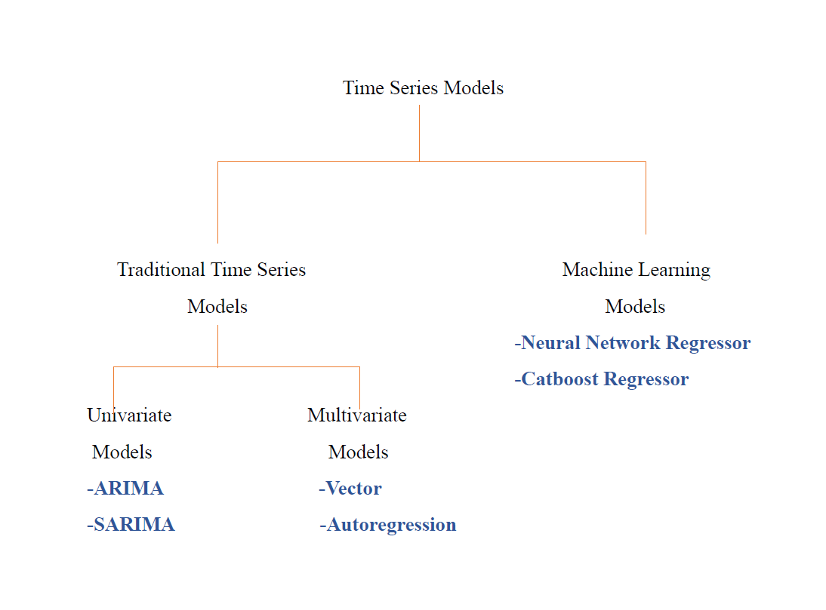
Types of Models of
Time Series Analysis

Slide 12
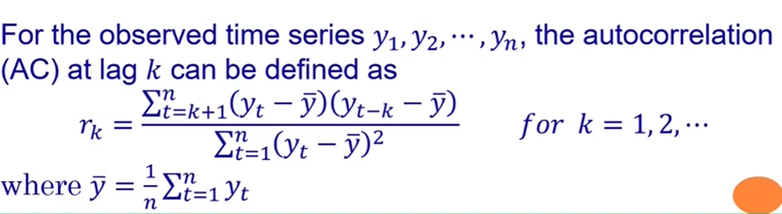
Autocorrelations
Autocorrelations is a statistical measures that indicate how a time series is related to itself over time.
Autocorrelations(AC):

Slide 13
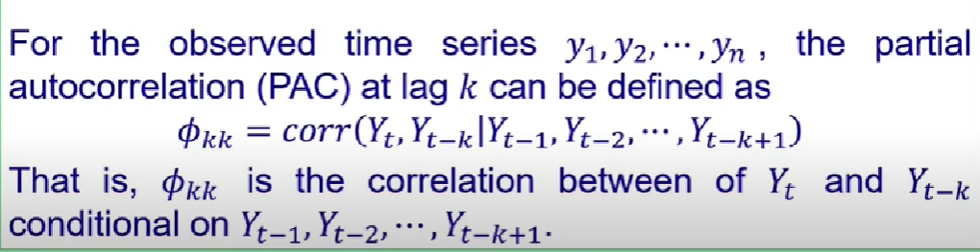
Partial Autocorrelation
Partial Autocorrelation(PAC):

Slide 14
Objectives of Time Series Analysis
The main objective of time series analysis is
Modeling And Forecasting: To fit the model and then proceed the forecast for future

Slide 15
Smoothing(Filtering) a time series
Smoothing is a form of filtering which produces a time series in which the importance of spectral components at high frequency is reduced.
Kernel smoothing
Loess Smoothing
Splines Smoothing
Smoothing one series as a function of another

Slide 16
Model: ARIMA
The Auto-Regressive Integrated Moving Average (ARIMA) are a class of linear models that is capable of representing stationary as well as non-stationary time series.
ARIMA (p, d, q)
Order of AR
Order of MA
Order of “differencing”

Slide 17
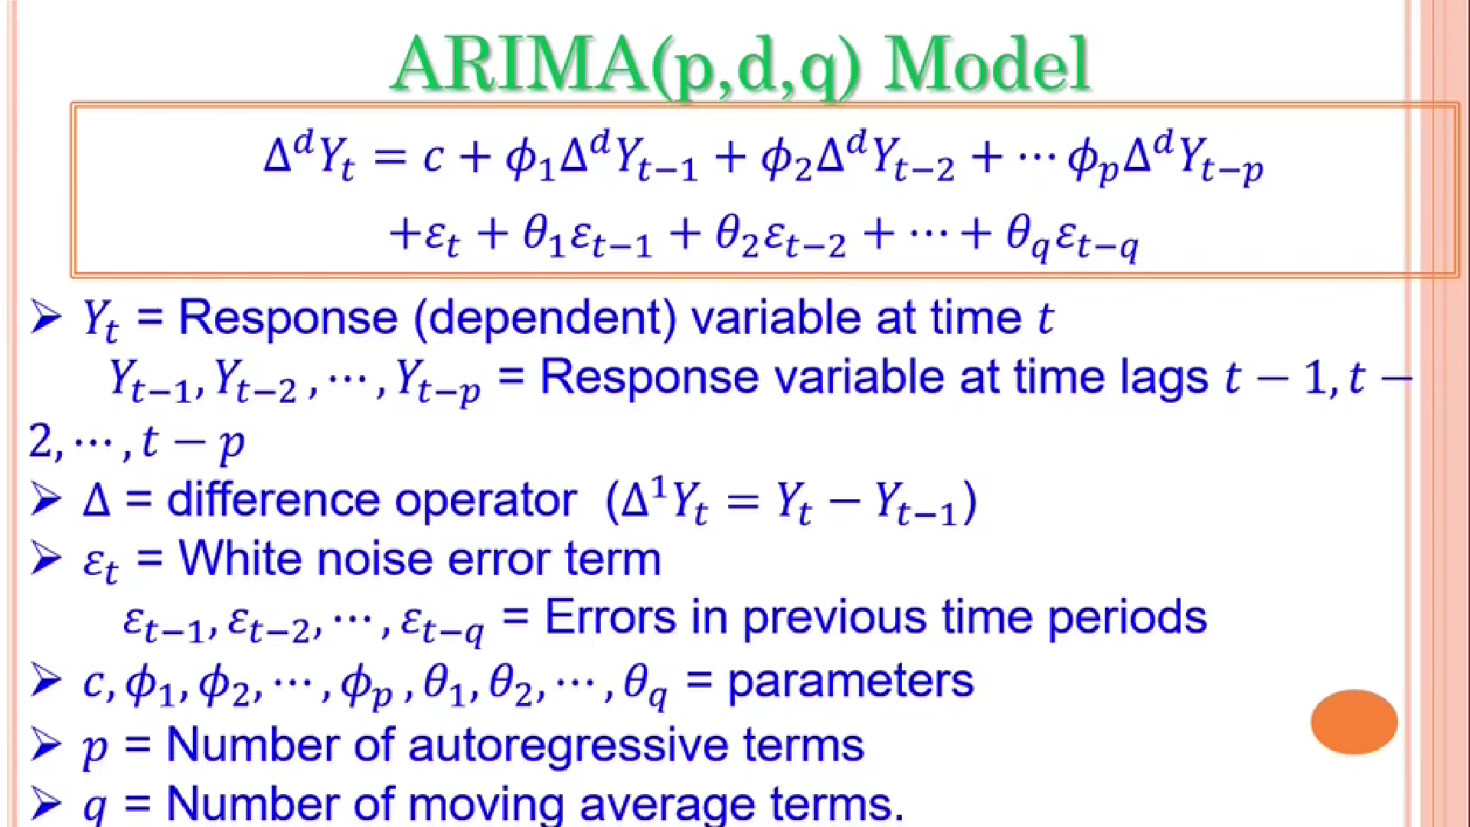

Slide 18
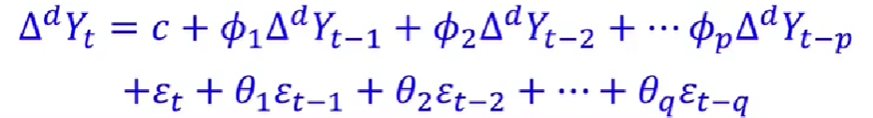
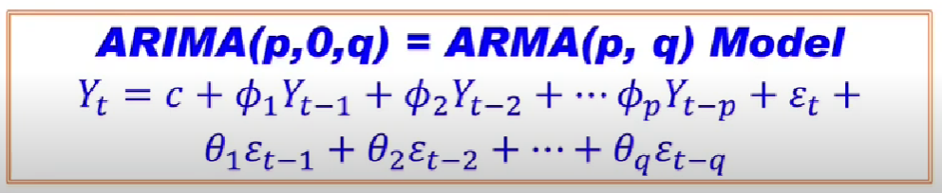
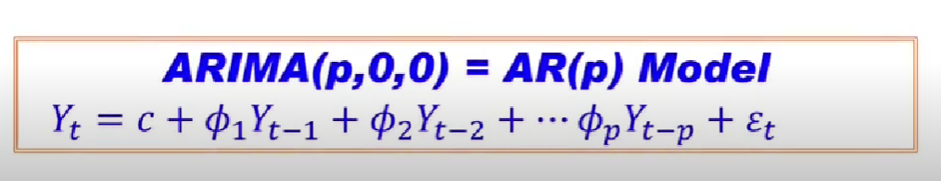
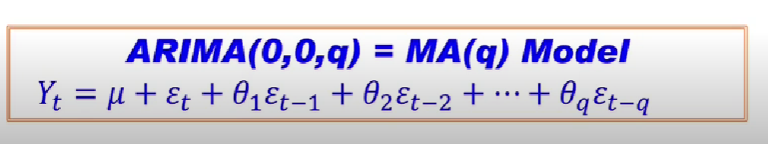
if d=0,
if d=0, q=0,
if p=0, d=0

Slide 19
Model: ARIMA (p, d, q)
ARIMA Model rely heavily on both Autocorrelation (AC) and Partial Autocorrelation (PAC) patterns in time series data.

Slide 20

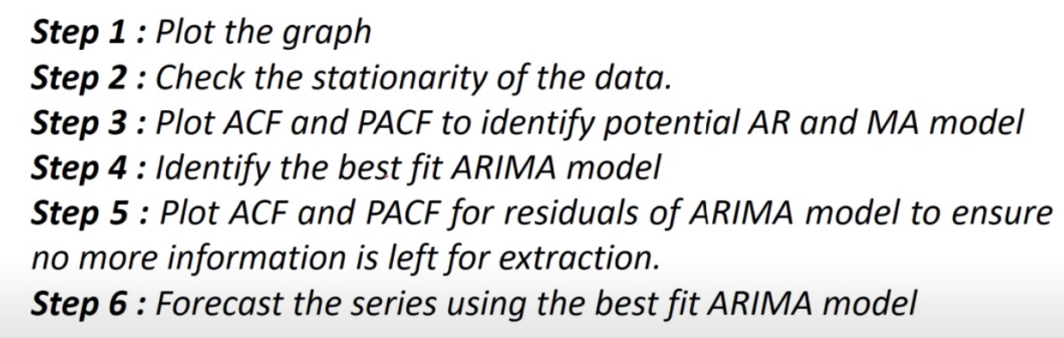
Machine Learning Algorithm of ARIMA model

Slide 21
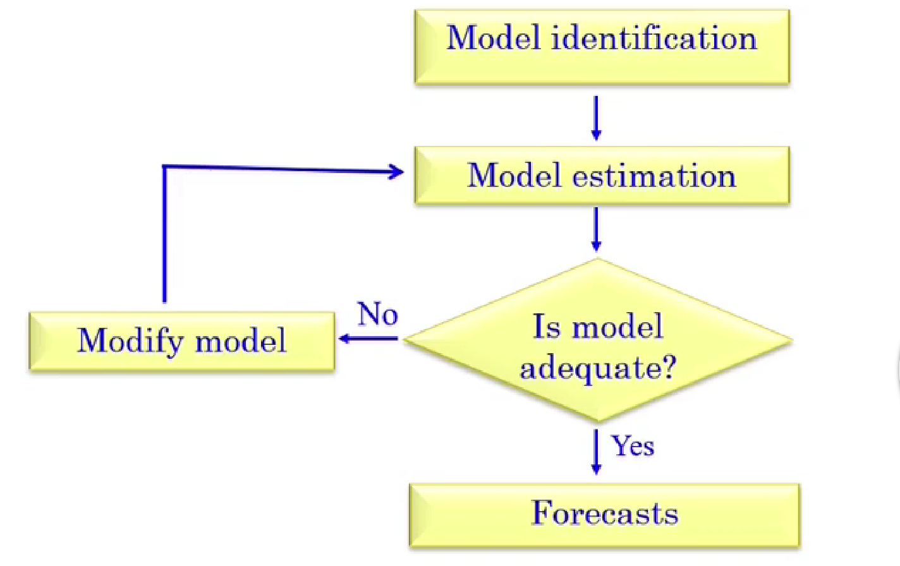
The box-Jenkins model building process

Slide 22
.
SARIMA
ARIMA is superseded by SARIMA in the fact that SARIMA can also accept a seasonal time series.
The Seasonal Autoregressive Integrated Moving Average (SARIMA) algorithm is a step-by-step procedure for modeling and forecasting time series data that exhibit both seasonal and non-seasonal patterns. The Autoregressive (AR), Integrated (I), and Moving Average (MA) parts of the model remain as that of ARIMA. The addition of Seasonality adds robustness to the SARIMA model
They are widely used in various fields, including economics, finance, retail, and climate science, to make informed predictions and decisions based on historical data.

Slide 23
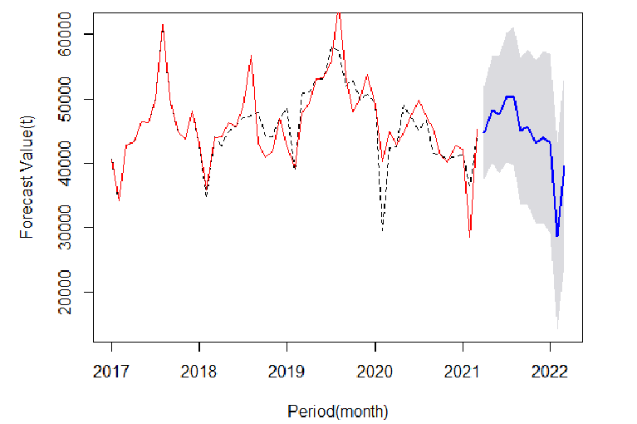
.
SARIMA
Figure 01: Forecast value in respect of the period (per year)

Slide 24
SARIMA (period=s)
(p,d,q)
(P, D,Q)m
Non-seasonal part
Seasonal part
Key Components of the SARIMA Model:
Non-Seasonal Autoregressive (AR): 'p' captures non-seasonal dependencies.
Non-Seasonal Differencing (I): 'd' achieves stationarity for non-seasonal trends.
Non-Seasonal Moving Average (MA): 'q' models non-seasonal noise.
Seasonal Autoregressive (SAR): 'P' captures seasonal dependencies.
Seasonal Differencing (SI): 'D' achieves seasonality stationarity.
Seasonal Moving Average (SMA): 'Q' models seasonal noise.
Seasonal Period (s): 's' defines the number of time units in one seasonal cycle.
These components help SARIMA model both non-seasonal and seasonal patterns for accurate time series forecasting.

Slide 25
SARIMA
Here's a concise step-by-step guide to implementing a SARIMA model in time series analysis:
Data Preparation: Ensure data stationarity, The term "stationarity" refers to a statistical property of a time series in which its statistical properties remain constant over time and apply differencing if needed.
Model Identification: Determine p, d, q, P, D, and Q using ACF, PACF plots, or automated methods.
Model Estimation: Fit the SARIMA model using identified parameters (e.g., with Python’s StatsModels or R's forecast package).
Model Diagnostics: Check model fit through residual analysis and ACF/PACF of residuals.
Forecasting: Use the model for future forecasts, generating point predictions and prediction intervals.
Evaluation: Assess forecast accuracy using metrics like MAE, MSE, or RMSE.

Slide 26
ARIMA & SARIMA
Advantages of ARIMA & SARIMA
1. Simple to comprehend and apply: The simplicity and interpretability of the models are the one thing that your coworkers and colleagues would value. Presentations to stakeholders will go better if you concentrate on each of these while preserving the standard of the output.
2. Limited variables: only a few variables Since there are fewer hyperparameters, it will be simple to maintain the configuration file if the model is put into use.

Slide 27
ARIMA & SARIMA
Disadvantages of ARIMA & SARIMA
Exponential time complexity: If p and q are high, there are more coefficients to fit as p and q increase, which multiplies the time complexity. Due to their difficulty in implementation, both of these algorithms have Data Scientists looking towards Prophet and other techniques. However, it also relies on how complex the dataset is.
Data complexity: It's possible that your data is too complex and there isn't an ideal answer for p and q. The failure of ARIMA and SARIMA is quite unlikely, but if it does happen, you might have to go elsewhere.
Amount of data needed: Both algorithms require a large amount of data to operate, especially if the data is seasonal. For Short Life-Cycle Products, for instance, using three years of historical demand is probably insufficient for a reliable estimate.

Slide 28
ARIMA & SARIMA
Real Life Use-cases of ARIMA & SARIMA
1. This study applied ARIMA to forecast COVID-19 cases in India. However, ARIMA's limitation lies in its reliance on historical data, which may not fully capture the dynamic nature of COVID-19 due to its complex dependencies on various behavioral factors.
2. Solar radiation prediction in Seoul, South Korea using SARIMA based on 37 years of hourly data from the Korean Meteorological Administration.
3. Disease management with ARIMA, including a case of predicting hospital bed demand during the SARS epidemic in Singapore.
4. Forecasting demand in a food company using ARIMA.

Slide 29
ARIMA & SARIMA
Real Life Use-cases of ARIMA & SARIMA
However, there are a few things to bear in mind while you work on them in your actual use case:
1. The temporal complexity of training can rise exponentially when p,q is raised. It is therefore recommended to determine their values first, then to explore.
2. They have a tendency to overfit. Therefore, before switching to production, be sure to set the hyperparameters correctly and perform validation.

Slide 30

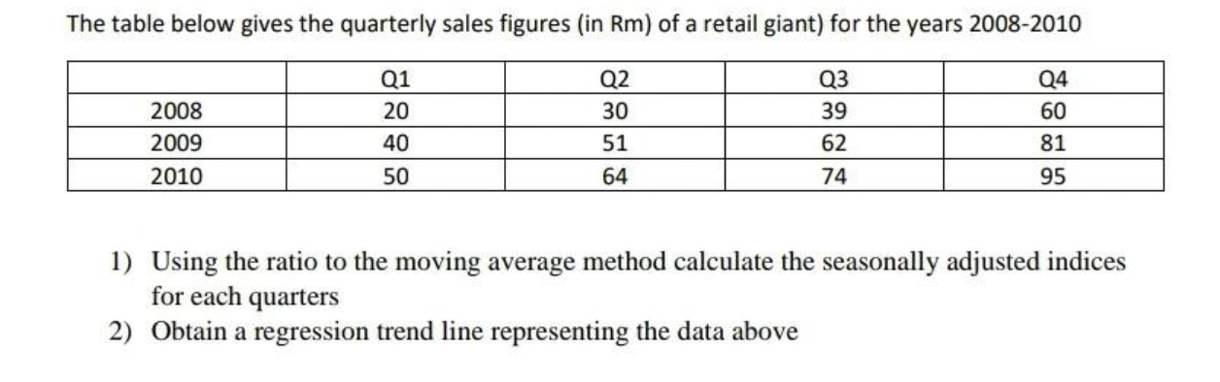
Time Series Analysis Math
3) Obtain a seasonally adjusted trend estimate for the 4th quarter of 2011

Slide 31
MA (Moving Average) method & Seasonal Adjustment
A moving average is a series of averages, calculated from historic data. Moving averages can be calculated for any number of time periods, for example a three-month moving average, a seven-day moving average, or a four-quarter moving average. The basic calculations are the same.
Seasonal Adjustment is the removal of the "seasonal" part from the data so that we can see the underlying "regular" trend more clearly.

Slide 32
Time Series Analysis Math
3) Obtain a seasonally adjusted trend estimate for the 4th quarter of 2011

Slide 33
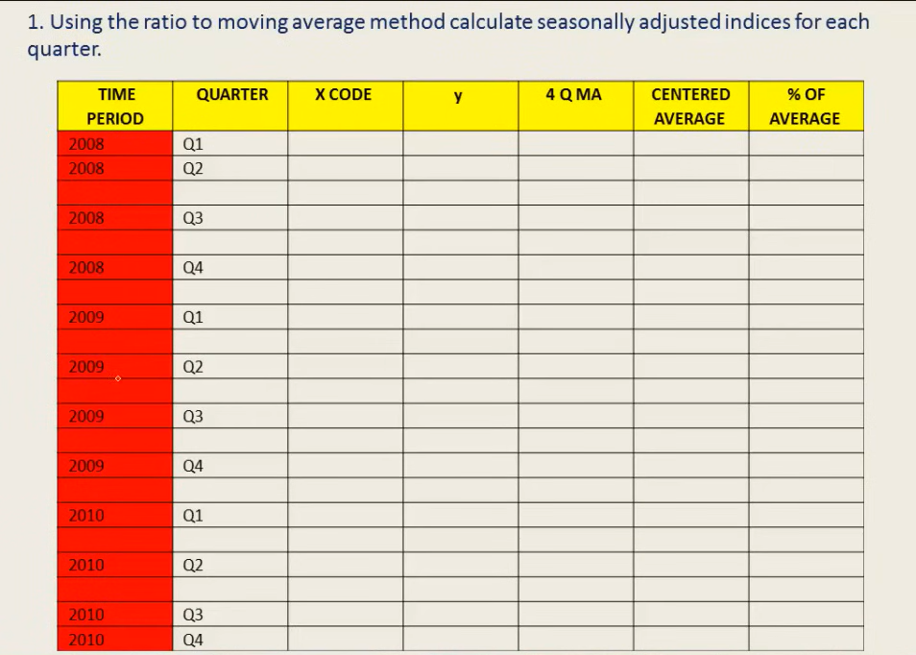

Slide 34
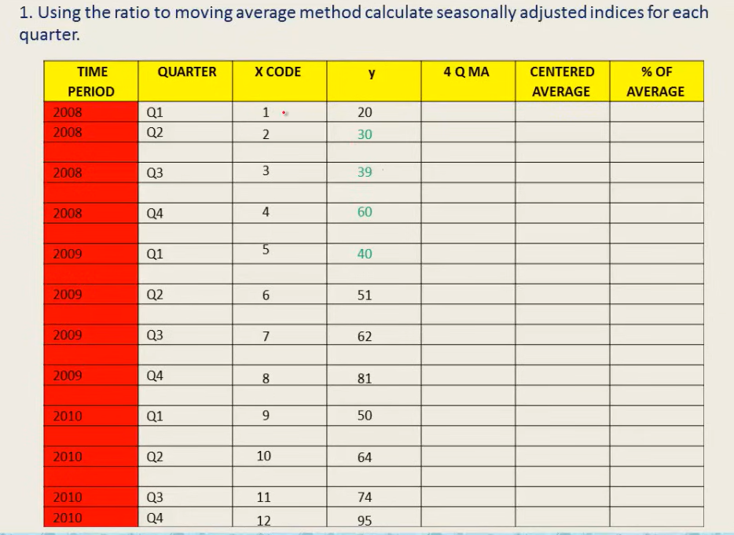

Slide 35
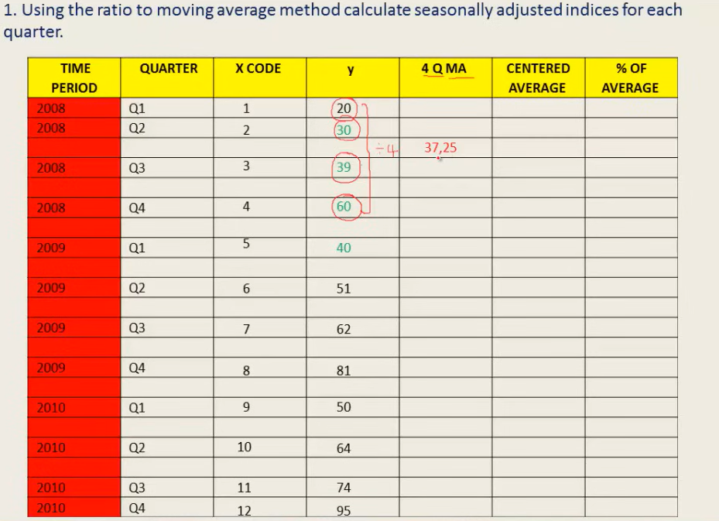

Slide 36
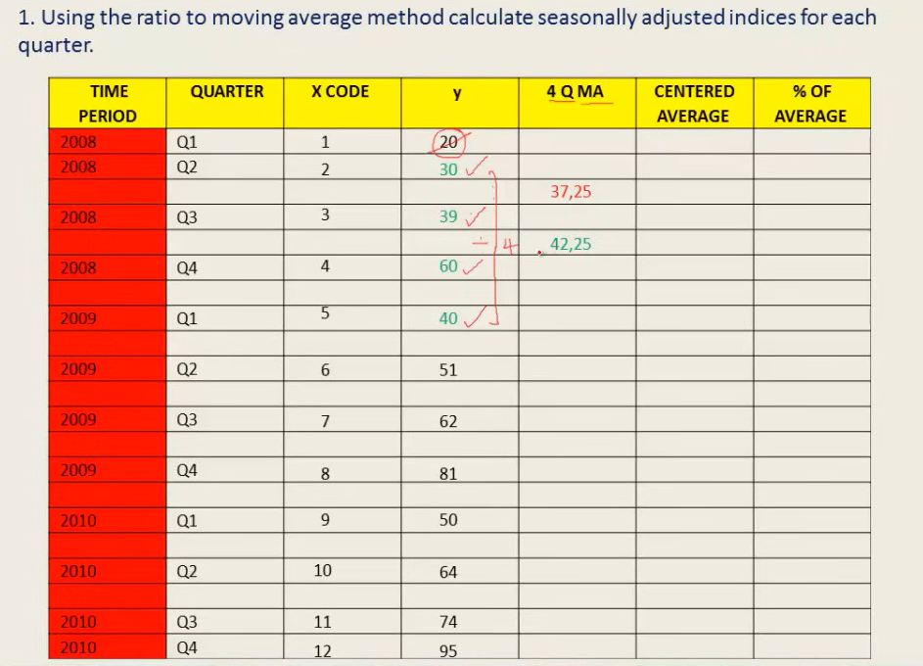

Slide 37
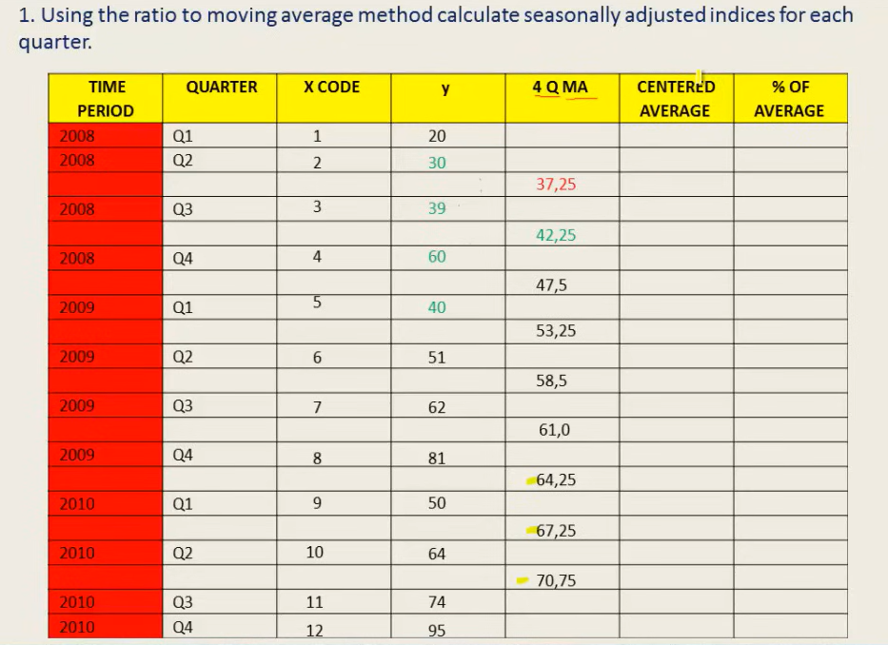

Slide 38


Slide 39
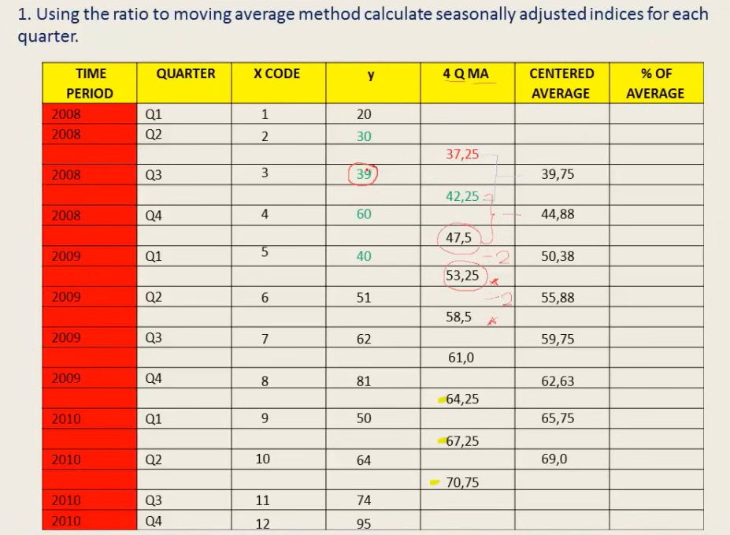

Slide 40
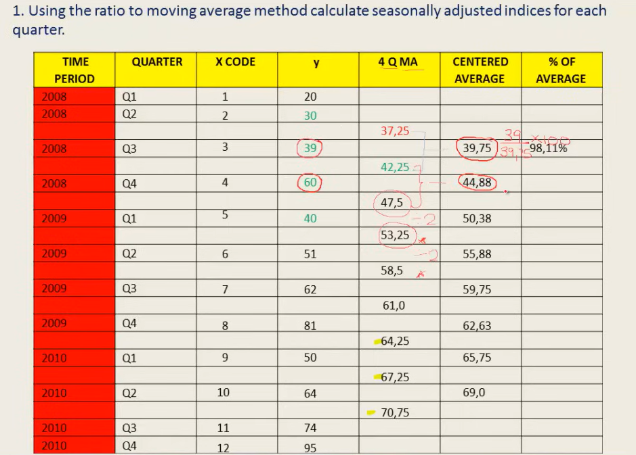

Slide 41
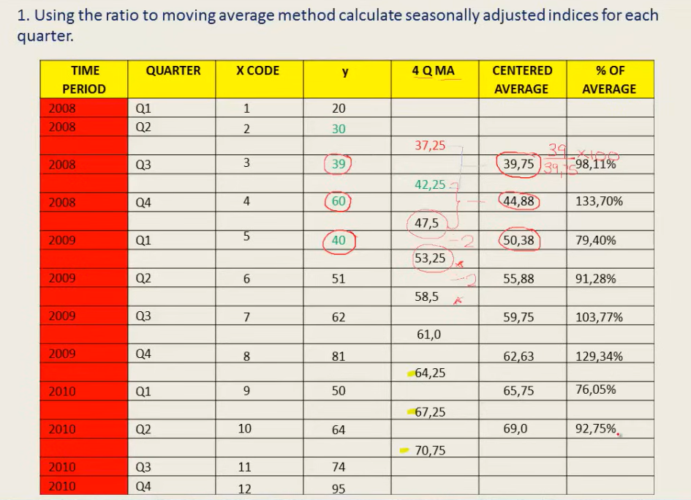

Slide 42
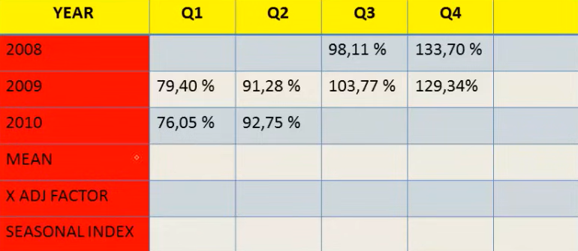

Slide 43
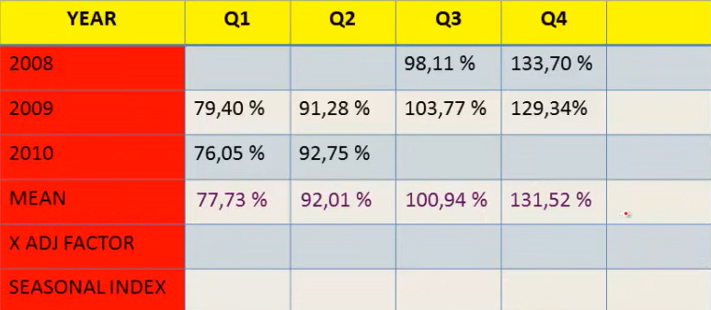
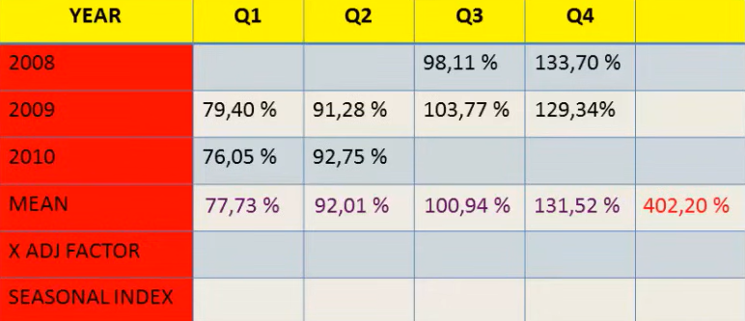

Slide 44
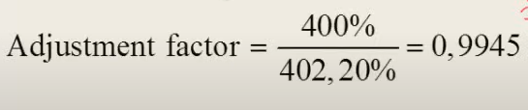
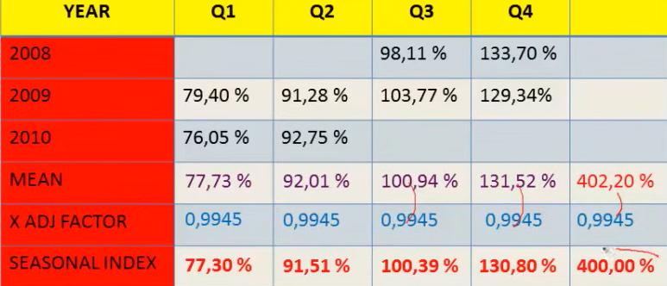


Slide 45
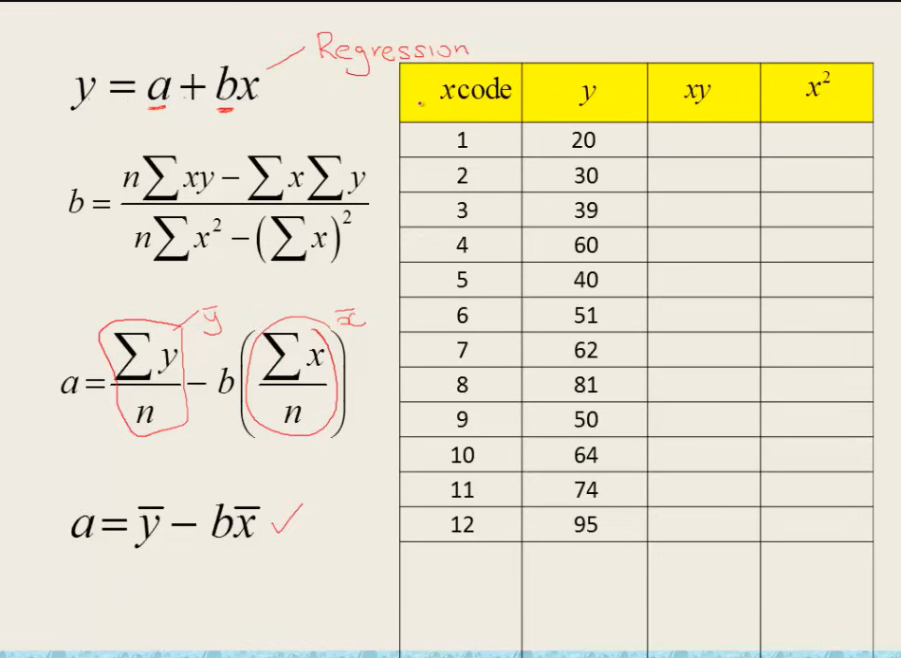


Slide 46
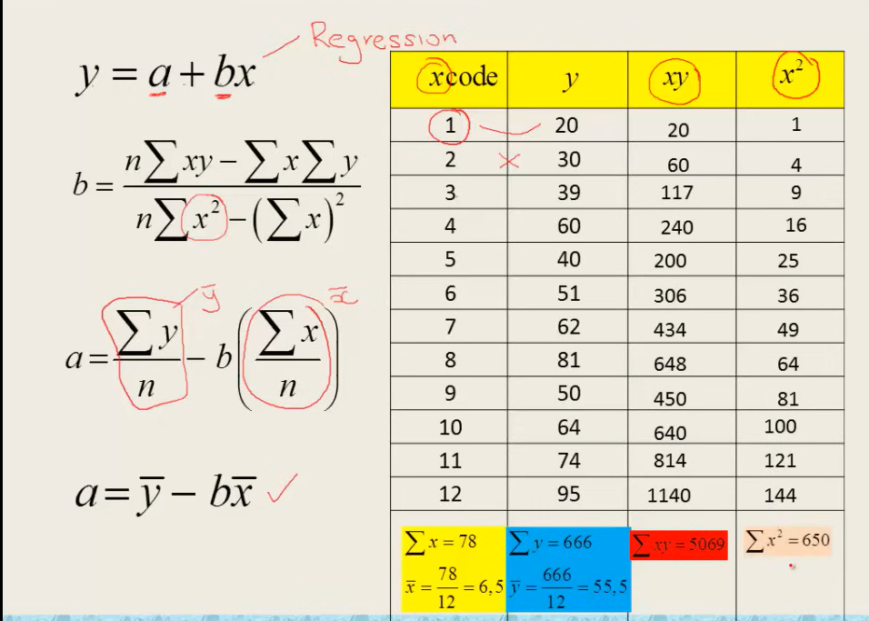

Slide 47
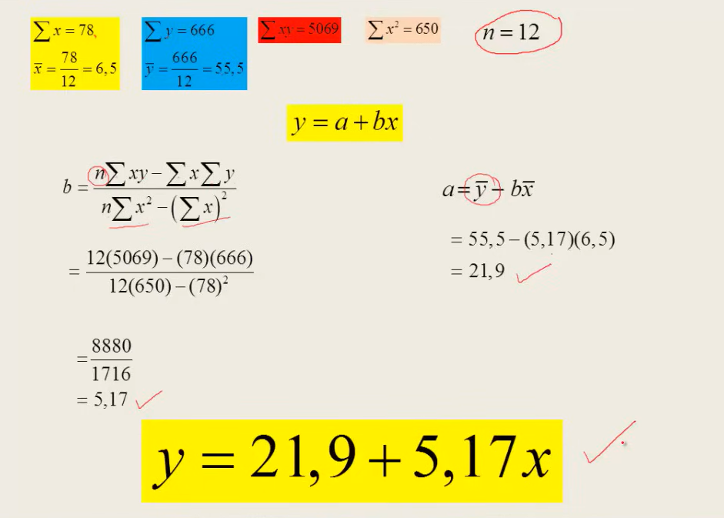

Slide 48
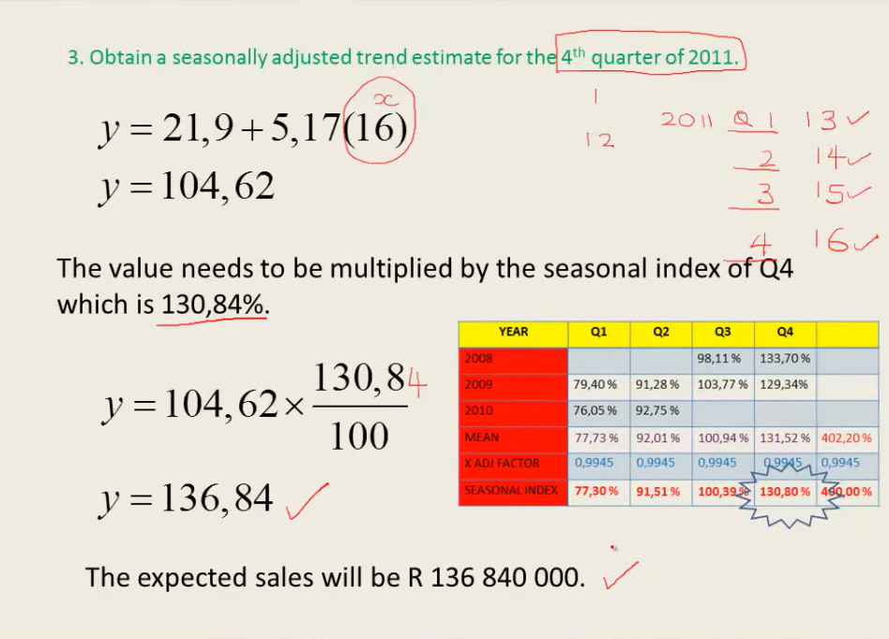

Slide 49
Applications in various domains
Financial Forecasting
Time series analysis helps predict stock prices, currency exchange rates, and market trends, aiding investment decisions.
Demand Forecasting
Businesses use time series analysis to anticipate product demand, optimize inventory, and ensure efficient supply chain management.
Anomaly Detection
Time series analysis identifies unusual patterns in data, critical for fraud detection, cybersecurity, and fault detection in industrial processes.

Slide 50
Applications in various domains
Sales Prediction:
Retailers leverage time series analysis to forecast sales, tailor marketing strategies, and optimize pricing for better revenue outcomes.
Disease Outbreak Prediction:
Health organizations utilize time series analysis to monitor and predict disease outbreaks, enabling timely responses and resource allocation.
Disease Outbreak Prediction:
Identify trends and seasonality in weather data, enabling meteorologists to make accurate short-term and long-term weather predictions.

Slide 51
Advantages
Disadvantages
High Predictive Accuracy.
Data-Driven Insights
Automation and Scalability
Sensitivity to Outliers
Limited Historical Data
Complexity

Slide 52


References
Arima and Sarima Models -
https://neptune.ai/blog/arima-sarima-real-world-time-series-forecasting-guide?fbclid=IwAR3ka_Bt4Fwk55n69jOYR8jp8Tu1PPnxtxUKYlmQWicyKwDC-nvQpcJ6MqE
Arima Model –
https://www.youtube.com/watch?v=V-GG4ZkyynQ&ab_channel=StatisticsTime
Time Series Math –
https://www.youtube.com/watch?v=HIWXdHlDSFs&ab_channel=AdhirHurjunlal
Moving Average definition-
https://www.accaglobal.com/gb/en/student/exam-support-resources/fundamentals-exams-study-resources/f5/technical-articles/time-series.html
Seasonal Adjustment definition-
https://www.investopedia.com/terms/s/seasonal-adjustment.asp#:~:text=Seasonal%20adjustment%20is%20a%20method,be%20overshadowed%20by%20seasonal%20differences.

Slide 53
T
Thank you

